Slide 1
Challenges in the Development of Clinical Studies in ME/CFS
All materials can be found at: www.meaction.net/workshop
Engaging people with lived experience as research partners
Recruitment of under-represented populations

Slide 2
Jaime Seltzer, MS
Jaime Seltzer is the Director of Scientific and Medical Outreach at the nonprofit advocacy organization #MEAction. She works with Stanford, Columbia, Mayo Clinic, and Project ECHO on post-infectious chronic complex diseases, including ME/CFS and Long COVID, and is running a survey-based study and small proteomics mass spectrometry project on these diseases.
Contact: jaime@meaction.net, seltzer1@stanford.edu

Slide 3
Agenda
01
Concepts
02
Activity 1
03
Concepts
04
Activity 2
ENGAGING RESEARCH PARTNERS WITH LIVED EXPERIENCE
Planning and Budgeting for Research Partners with Lived Experience
RECRUITING UNDER-REPRESENTED POPULATIONS
Recruiting Underrepresented Populations in ME/CFS Research

Slide 4
1) Planning and Budgeting for Research Partners with Lived Experience 2) Recruitment of underrepresented populations in ME/CFS research
Activities

Slide 5
01
ENGAGING RESEARCH PARTNERS WITH LIVED EXPERIENCE
Patients as research partners Crafting a successful collaboration
Potential impacts of inclusion Patient involvement at every stage Case study 1 Case study 2
Back
Next

Slide 6
Patients as research partners
The integration of people with lived experience in studies that can go on to affect their lives has been called a “moral imperative” in research.
“Nothing about us without us”
Is there also a measurable effect on outcomes researchers value?

Slide 7
Potential Impacts of Patient Inclusion:
Research quality
01
Patients’ knowledge & personal experience leads to better research questions, design
Translation, dissemination, uptake of results
02
Patients can serve as ‘early ambassadors’ for research
Increased interest in the field = more funding over time
Applicability, success of research
03
Can ensure you recruit—and therefore results are applicable to—a true, diverse, representative sample of affected persons
Feeling of ‘ownership’, wholehearted engagement → retention
Esmail, L., Moore, E., & Rein, A. (2015). Evaluating patient and stakeholder engagement in research: moving from theory to practice. Journal of comparative effectiveness research, 4(2), 133–145. https://doi.org/10.2217/cer.14.79

Slide 8
Potential Impacts of Patient Inclusion:
Accountability & legitimacy
04
Community involvement = more likely that publicly-funded research serves public interest
Moral obligation
05
Patients have a fundamental right to involvement in research that can determine how their disease is treated & viewed
Esmail, L., Moore, E., & Rein, A. (2015). Evaluating patient and stakeholder engagement in research: moving from theory to practice. Journal of comparative effectiveness research, 4(2), 133–145. https://doi.org/10.2217/cer.14.79

Slide 12
Recruiting partners with lived experience
Diversity of representation is important
Anticipate drop-off: over-recruit
Recruit through advocacy organizations and patient-led groups

Slide 13
Crafting a successful collaborative environment
Allocate funding to engage people with lived experience.
Conceptualize as a long-term relationship
Clear expectations re: time commitment, project length, timeline, hierarchy/roles (clarity on decision-making processes), how patient input will be incorporated
Flexibility in timing, method, & mode of communication
Brief meetings with set agendas
Opportunity for patients to rest during/between in-person meetings

Slide 14
02
ACTIVITY: Planning and Budgeting for Research Partners with Lived Experience
Check the chat box for a link to this activity.
Fill it out online OR Print it out OR
Stay tuned to see the questions in the presentation itself
Back
Next

Slide 15
From: National Institute for Health Research . Patient and Public Involvement in Health and Social Care Research: A Handbook for Researchers. Leeds: NIHR; https://www.nihr.ac.uk/about-us/CCF/funding/how-we-can-help-you/RDS-PPI-Handbook-2014-v8-FINAL.pdf

Slide 16
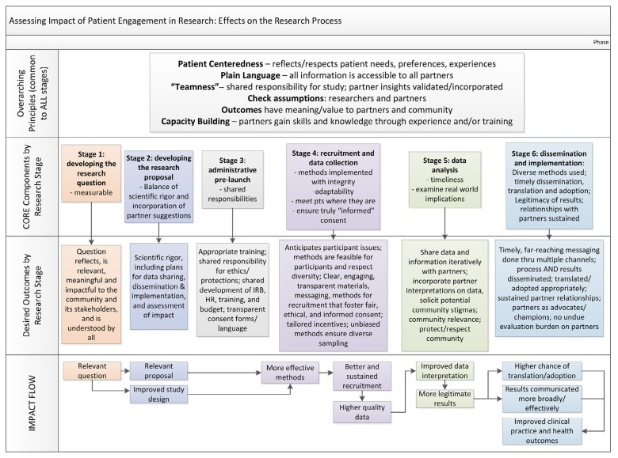
Dillon, E. C., Tuzzio, L., Madrid, S., Olden, H., & Greenlee, R. T. (2017). Measuring the Impact of Patient-Engaged Research: How a Methods Workshop Identified Critical Outcomes of Research Engagement. Journal of patient-centered research and reviews, 4(4), 237–246. https://doi.org/10.17294/2330-0698.1458, reproduced with permission from Advocate Aurora Health.

Slide 17
Activity 1: Planning & Budgeting for Research Partners with Lived Experience
Title of your study
What are the advantages to engaging research partners with lived experience in this study in particular? Why is it important here; what problems might it help you solve?
For each step in the research process below, discuss how partners with lived experience will engage. A) Research Question B) Research Proposal C) Pre-launch D) Recruitment & Data Collection E) Data analysis F) Dissemination/Implementation
Given the responsibilities outlined as above, I anticipate I will bring ___(#) people with lived experience into this project.
We will engage patient partners to be: A) Core members of the team B) Consultant(s) who engage with our core team less frequently C) Members of a group or committee who engage with a chosen representative from our team
Given the above, I expect that people with lived experience will engage every [week/month/quarterly/yearly] over a period of ___ [months/years].
(Number of people from question 4) x (Value 1 from question 6) x (Value 2 from question 6) x (Cost per ‘engagement’ per person) = Staff time for management, if applicable =
Total investment in partnership =

Slide 18
03
RECRUITING UNDERREPRESENTED POPULATIONS in ME/CFS
ME/CFS recruitment challenges Sedentary controls
Severe patients BIPOC patients
Case study 1 Recruitment strategies
Back
Next

Slide 19
ME/CFS studies present challenges in recruitment
Sedentary controls ensure results cannot be explained by deconditioning
Omission of BIPOC and severe patients can limit generalizability of results/impact external validity
Appropriate comparator populations include:
Multiple sclerosis; Long COVID/PASC; autoimmune disease
Fatigue - ‘cancer fatigue’
Cognitive dysfunction - ADHD, dementia, post-chemotherapy/’cancer fatigue’

Slide 20
Recruiting populations of concern
Sedentary controls
Sources:
Organizations that study sedentary controls
College campuses
Physical therapy practices
Paid recruitment services
Ensure patients are sedentary using objective measures, like actimeter data/data from wearable devices

Slide 21
Recruiting populations of concern
Severe patients
Connect with expert clinicians and online support groups
Be aware of and accommodate patients’ extremely low energy levels
Use mobile phlebotomy services and home visits whenever possible
For more on inclusion of severe patients as patient partners in study design, execution, and translational efforts see: Ethical considerations for engaging frail and seriously ill patients as partners in research

Slide 22
Recruiting populations of concern
BIPOC patients
Consider community-based clinics for diagnosis & recruitment; Federally Qualified Health Centers (FQHCs)
Find ‘champions’ in marginalized groups to help advise researchers and promote the study
Engage with/advertise to publications by/for your pop of interest
Engage with BIPOC-centered healthcare organizations
Work with BIPOC fraternities / sororities
Churches, temples, spiritual centers and community centers
Veterans’ administration clinics
Cooperate with existing initiatives w/similar goals

Slide 24
Recruitment Strategies for Challenging Populations
Transportation
Bus ride vouchers
Uber/Lyft gift certificates
Compensation for gas/mileage
Mobile phlebotomists for patients too ill to come in person
Childcare
Highlight nearby childcare facilities
Provide childcare on-site

Slide 25
04
ACTIVITY: Recruiting Underrepresented Populations in ME/CFS Research
Check the chat box for a link to this activity.
Fill it out online OR Print it out OR
Stay tuned to see the questions in the presentation itself
Back
Next

Slide 26
Activity 2: Recruiting underrepresented populations
Title of your study
What are advantages of increasing recruitment in the populations on which you’ve chosen to focus? Why is this important (internal/external validity).
You have ___ points to spend on to ‘spend’ on outreach. Each point represents an investment of time, money, and energy into the outreach process. What strategy or effective combination of strategies will you use? Consider mixed methods.
No matter how many ‘points’ you have to spend, too many different methods of outreach will overwhelm your study coordinator. Choose no more than six strategies for your study and list them below, making sure that you do not go beyond your point outreach total.

Slide 27
General Strategies Contact advocacy organizations, e.g. #MEAction, Solve ME for study promotion (1) Post on ME/CFSnet website (1) Utilize Clinical and Translational Science Awards (CTSAs) hubs(1) Partner with the Community Advisory Committee (2) Post on Clinical Trials.gov (note: non-interventional studies are allowed) (2) Use site-specific recruitment services (eg Columbia University Recruit Me) (2) Use paid recruitment services such as researchmatch.org (3) Partner with ME/CFS clinical sites in the region, Bateman-Horne, Simmaron Research, Stanford ME/CFS, etc. (3) | Severely ill patients Contact social media groups for severely ill patients and caregivers (1) Partner with multiple ME clinics and/or clinicians in order to reach recruitment goals for severe patients (4) Use mobile phlebotomy services to increase participation from home (4) | BIPOC patients Reach out to: Clinical settings such as Federally Qualified Health Centers (FQHCs) (4) Organizations for medical providers and public health organizations that serve BIPOC communities (3) Local ESL learning centers and translate recruitment flyers into multiple languages (3) Organizations such as WEGO Health to identify patient leaders in your target population(2) BIPOC fraternities and sororities and/or National Pan-Hellenic Council (The “Divine Nine”) (4) Religious, spiritual and community centers (4) Veterans Administration Clinics (4) Advertise in outlets that focus on your target population, including: Advertisements in magazines/journals (2) Podcasts (5) Social media (1) Consider use of the DePaul Symptom Questionnaire (DSQ) before assessment by an expert to expand the potential subject pool.
 | Sedentary Controls College campuses for young, sedentary controls from university health centers Physical therapy practices with access to subjects who are healthy yet sedentary Clinical entities, such as the Bateman-Horne Center, with a connection to a university hospital system, or large-scale care providers such as Kaiser or One Medical
 | Men Place online flyers within groups designated for men with ME/CFS, such as the #MEAction Men’s Facebook Group (1) Advertise in outlets that focus on men and men’s issues, especially in healthcare (2)

Slide 28
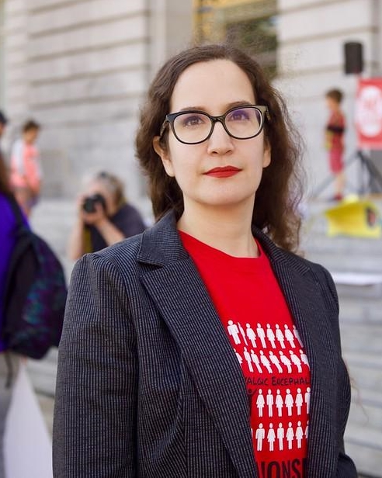
All workshop materials can be found at: www.meaction.net/workshop Thank you
#MEAction
Columbia Mailman School of Public Health, ME/CFS Collaborative Research Network CAC Study Feasibility Working Group, Jaime Seltzer, Dr. Susan Taylor-Brown, Kathi Kuhnel, Cheryelle McFarlane US Public Health Services grant5U54A/138370 and 5U24NS105535
Contact: jaime@meaction.net, seltzer1@stanford.edu

