Slide 1
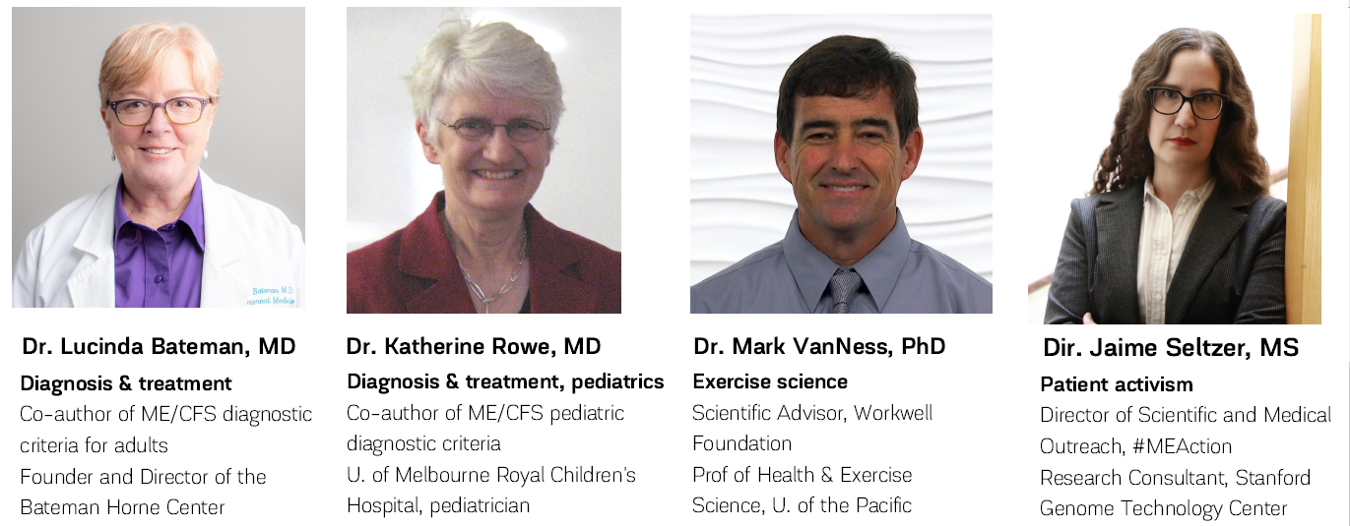




Welcome!
Dr. Lucinda Bateman, MD Dr. Mark VanNess, PhD Dr. Katherine Rowe, MD

Slide 2

Jaime Seltzer
Director of Scientific & Medical Outreach, #MEAction www.meaction.net jaime@meaction.net

Slide 3
What is #MEAction? (www.meaction.net)
#MEAction is a global, 501(c) nonprofit advocacy organization
Provides resources for advocacy actions with the support of hundreds of volunteers
Advocates for public investment in research, healthcare, and medical education
Resources include:
  medical education; seminars
  news and social media summarizing ME conferences
  social media support groups
  MEpedia
  community calls
  informative emails with a reach of +35K people with ME and allies
Partnerships with other orgs for greater impact

Slide 4
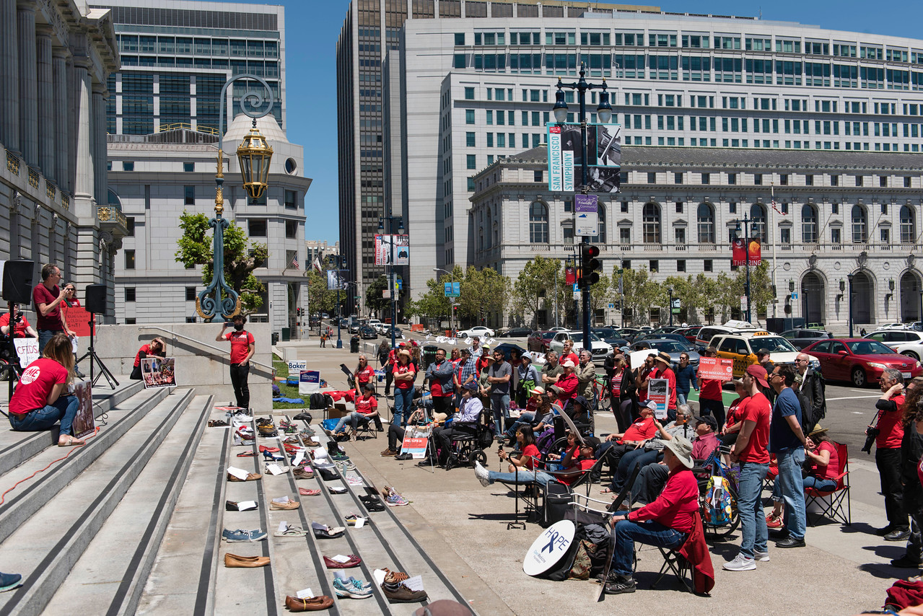
#MillionsMissing fights for research funding and recognition
#MEAction led actions in over 100 cities worldwide for in-person protests to fight for better research funding for ME.
Protest demands for equitable research funding were delivered to the NIH with thousands of signatures.
As our most visible action, #MillionsMissing is often what #MEAction is known for.

Slide 5
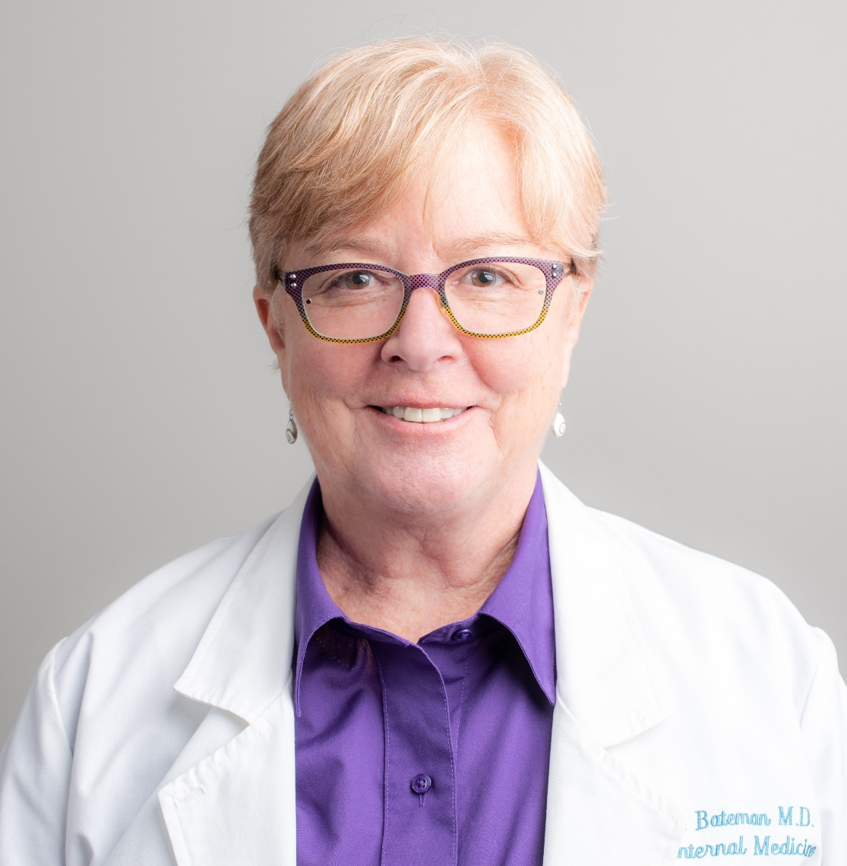
Dr. Lucinda Bateman, MD
Director of Bateman-Horne center

Slide 6
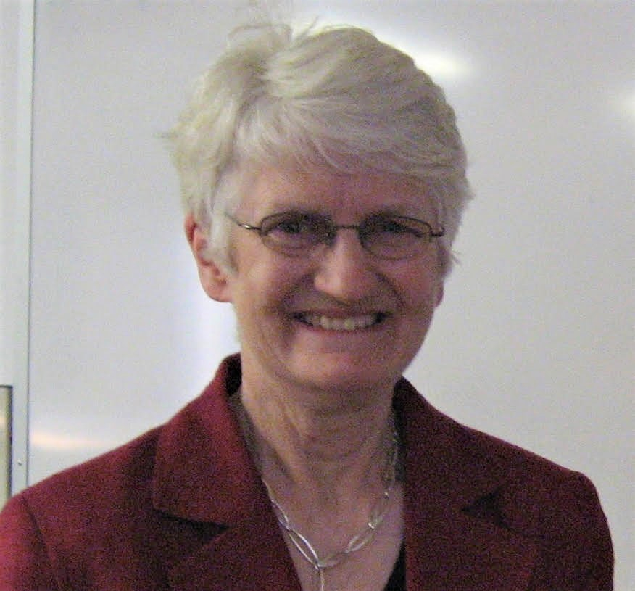
Dr. Katherine Rowe, MBBS, MD
U. of Melbourne Royal Children’s Hospital, Pediatrics

Slide 7
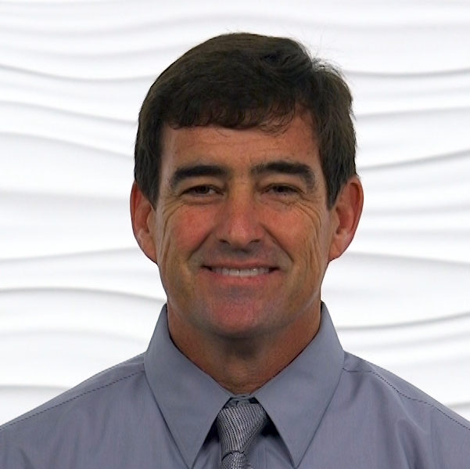
Dr. Mark VanNess, PhD,
Prof. of Health & Exercise Science, U. of the Pacific

Slide 8
Post-viral ME/CFS
Diagnosing and treating people with ME/CFS
in the context of COVID-19

Slide 9


Post-viral syndromes,
Post-viral ME/CFS, and likely… post-COVID-19 illness
Lucinda Bateman MD
2020

Slide 10
ME/CFS
Myalgic Encephalomyelitis/Chronic Fatigue Syndrome
A chronic, debilitating, multisystem illness characterized by central and peripheral nervous system disease, immune manifestations, and impaired cellular metabolism.
ME/CFS is thought to be a post-viral or post-infection syndrome
in most, but not all cases

Slide 11

ME/CFS Historical Background
ME/CFS is associated with many other names, including:
  Neurasthenia--- The Diseases of the Nervous System, 2nd ed. New York, Appleton, pp.529-38. Hirt, L. (1899)
  Icelandic disease (1946-47 outbreak of polio-like illness)
  ME – “Benign” Myalgic Encephalomyelitis (1950s)
  Post-Viral or Post-Infectious Fatigue Syndromes
  Chronic mono or Chronic Epstein Barr or Chronic EBV (1980s) [the role of EBV remains uncertain]
  CFS - Chronic Fatigue Syndrome (a term coined in 1988 in the US)
  CFIDS- Chronic Fatigue Immune Dysfunction Syndrome (a term adopted by advocates to replace “CFS”)
ME/CFS is not a new illness.
ME/CFS is world-wide and multicultural.
  Comparable illnesses have been documented for centuries but historical comparisons are problematic.
ME/CFS is a description of a chronic multisystem illness, likely post-infectious, with neurologic, immune and metabolic dysregulation.
ICD10 code: Postviral fatigue syndrome, or ME = G93.3
Notes:
The name chronic fatigue syndrome was selected because a group of researchers believed a more specific name would be misleading and the chronic fatigue reflects the most common symptom. But the chronic fatigue is just one symptom among many so it does not accurately describe the illness. CFS is also known as chronic fatigue and immune dysfunction (CFIDS), myalgic encephalopathy (ME), neurasthenia, chronic Epstein-Barr, as well as a host of disrespectful terms, such as “yuppie flu.” EBV was thought to be causative agent, but investigation shows only a spurious correlation.
Comparable illnesses date back several centuries, some possibly linked to bacterial, viral, or protozoal infections. Small outbreaks of similar chronic fatigue disorders have been described in the medical literature since the 1930s. One of the most significant outbreaks of CFS occurred in Nevada in 1984 - this outbreak put CFS into the public arena.
(such as brucellosis, yellow fever, hepatitis, influenza, and malaria).

Slide 12
Demographics & Etiology

Slide 13
Basic Facts about ME/CFS in the US
ME/CFS
Affects 836,000 to 2.5 million Americans but 80-90% have not been diagnosed.
Affects women 3 times more than men. Occurs in patients younger than age 10 and older than age 70. Two peaks of onset: 11-19 years and a 30-40 years.
Likely more common in minority groups but most often diagnosed in Caucasians
25% bedbound/housebound; 75% unable to work or attend school.
Symptoms can persist for years, and most patients never regain their pre-disease functioning.
Costs the US: $17-24 billion annually in lost productivity and direct medical costs.
The cause of ME/CFS is not well understood, although the disease often follows an infection.
CDC website, IOM/NAM report, US ME/CFS Clinician Coalition handout

Slide 14
How is ME/CFS triggered?
150 ME/CFS patients queried by detailed survey reported the following factors to be associated with their ME/CFS onset. (Table 1).
Onset Factor No. of subjects % of subjects
Infectious illness 84 64
Stress or major life events 51 39
Exposure to chemical/environ/toxins 26 20
Recent international travel 25 19
Recent domestic travel 23 17
Other… 22 17
…
Onset Patterns and Course of Myalgic Encephalomyelitis/Chronic Fatigue Syndrome. Lily Chu, et al. Front Pediatr. 2019; 7: 12. doi: 10.3389/fped.2019.00012. PMCID: PMC6370741. PMID: 30805319

Slide 15
How is ME/CFS triggered?
Subject-reported infectious events related to ME/CFS-onset.
Type of infection No. of subjects (%)
Respiratory infection (sore throat, runny nose, cough, etc.) 33 39
Documented acute infection (herpes viruses, parvoB19, etc.) 29 35
Non-specific infection (fever, chills, sweats, myalgia) 28 33
Other 15 18
Abdominal infection (diarrhea, nausea, vomiting) 10 12
…
Onset Patterns and Course of Myalgic Encephalomyelitis/Chronic Fatigue Syndrome. Lily Chu, et al. Front Pediatr. 2019; 7: 12. doi: 10.3389/fped.2019.00012. PMCID: PMC6370741. PMID: 30805319

Slide 16

Onset type
90% reported a defined onset following an infection
most commonly, EBV (Epstein-Barr virus)
variety of other infections were documented
Months of onset peaked during the winter months – Very few had onset during typical stress periods such as the beginning of school year or examinations. Distribution more consistent with pattern of infections.

Slide 17
Onset type
Gradual onset (10%) was more commonly associated with orthostatic intolerance and hyperflexibility
Differential diagnoses for gradual onset
  depression (feels better not worse if does things but less willing to do them cf wanting to do things but feeling worse)
  School refusal cf wanting to go but not able
  Other illnesses – celiac, autoimmune disease, endocrine disease
Occasionally onset after a sequence of infections rather than single episode

Slide 18
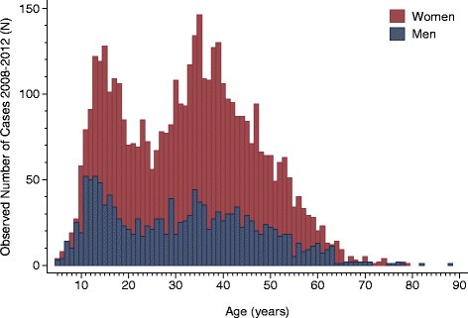
Age distribution from Norwegian study
Two age peaks in the incidence of chronic fatigue syndrome/myalgic encephalomyelitis: a population-based registry study from Norway 2008-2012
Large study from national data, ~5800
Peaks of diagnosis (not onset) ages 10-19 and in 30s
https://bmcmedicine.biomedcentral.com/articles/10.1186/s12916-014-0167-5

Slide 19
Demographics of young people
(in Australian context)
Specialist ME/CFS clinic in major pediatric hospital servicing state of 5.8 million.
Patients can live up to 3-4 hours drive from state borders
Multicultural city of nearly 5 million
Approximately 60% of population either born overseas or parents born overseas from 200 countries
280 languages spoken and 70 commonly spoken in the hospital. 23% speak language other than English at home
Universal health care with no restrictions on access and hospital clinics represent the population demographic

Slide 20
Demographics
1021 consecutive patients diagnosed with CFS.
The M:F ratio was 1:3
Mean age of onset 14.6 years; range 6-20 years.
(2% <10 and 4% <12) increasing through adolescence
The rural/urban mix was proportionate to the population
Socioeconomic status reflected the population.
However, the ethnic mix was not representative of the population of the state nor of the clientele of the hospital.

Slide 21
Ethnic mix of young people with ME/CFS
80% (811) had an Anglo-Celtic background (approximately 30% population), but predominantly Scottish/Irish descent (10% of population)
10.4% northern European (Dutch, Scandinavian which is <1% population)
Not representative of population or other general pediatric clinics in the hospital

Slide 22
?Genetic predisposition
17% reported first degree relative who had had similar prolonged recovery after infection or currently diagnosed with ME/CFS
In this population and age group, is the ethnic mix reflecting an increased susceptibility to prolonged recovery/autoimmune/ abnormal immune response?
Post-infection onset may not be reflected in the adult population

Slide 23
Clinical presentation of ME/CFS

Slide 24
ME/CFS is a debilitating multisystem disease
Beyond Myalgic Encephalomyelitis: Redefining an Illness. Institute of Medicine/National Academy of Medicine. Washington (DC): National Academies Press (US); 2015 Feb 10. ISBN-13: 978-0-309-31689-7ISBN-10: 0-309-31689-8

Slide 25
ME/CFS 2015 Clinical Diagnostic Criteria:
CORE criteria (required for diagnosis) *Must be moderate-severe and present >50% of time
1) Impairment of normal function, accompanied by fatigue, persisting >6 months
2) PEM: post exertional malaise*
3) Unrefreshing sleep*
4) Plus at least one of the following:
Cognitive impairment*
Orthostatic intolerance (autonomic nervous system dysregulation)
Additional common but not “CORE” features of illness in the ME/CFS population:
---Chronic pain (headache, muscle and joint aches, hyperalgesia, central sensitivity, tingling, burning…)
---Immune/inflammatory manifestations (allergy, inflammation, immunodeficiency, chemical sensitivities)
---Infection manifestations (viral or atypical infections, sore throat, tender lymph nodes, low grade fevers)
---Neuroendocrine manifestations (HPA-axis dysregulation, impaired stress response)
Beyond Myalgic Encephalomyelitis: Redefining an Illness. Institute of Medicine. Washington (DC):
National Academies Press (US); 2015 Feb 10. ISBN-13: 978-0-309-31689-7ISBN-10: 0-309-31689-8

Slide 26

What is PEM Following Physical Activity?
Exacerbation of Symptoms
Flare up
Worsening feeling and symptoms
Many are patient-reported and subjective
Waxing and waning – inconsistent
CPET provides objective measures

Slide 27

What is the PEM Timecourse?

Slide 28
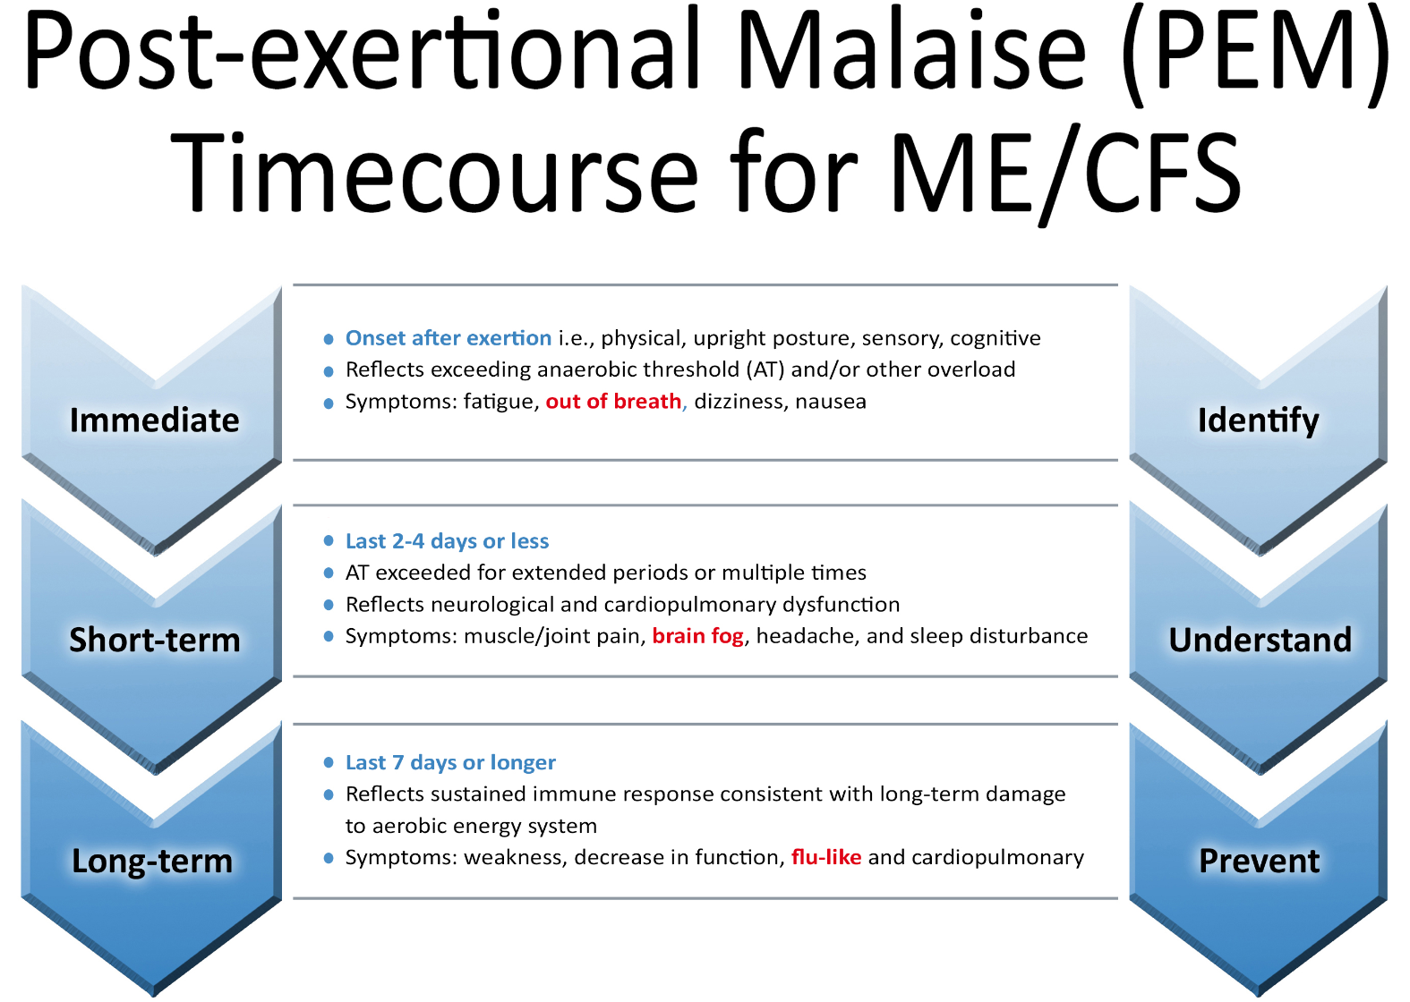

Slide 29
How to Identify PEM After Activity:
Do you experience severe fatigue with at least 3 symptoms after physical activity?
a. feel unwell
b. feel weak
c. don’t sleep well
d. have pain
Does it take a day or more to recover from exertion?

Slide 30
ME/CFS symptomatology is also associated with:
Orthostatic intolerance
Positive Antinuclear antibodies (ANA) but no evidence of specific autoimmune disease
Endocrine disorders (thyroid disease or diabetes)
Overtraining in athletes
After neurological insult (<1%)
Chronic sleep deprivation (reported commonly in Japan)

Slide 31
Orthostatic intolerance: postural orthostatic tachycardia syndrome (POTS) or neurally mediated hypotension (NMH)
POTS – may be associated with slow onset, hyperflexibility and variants of Ehlers Danlos Syndrome
May be associated with prolonged bed rest
Autonomic dysfunction can be triggered by viral or autoimmune diseases
Very common later in the illness
Need to determine whether POTS is associated with hyperflexibility or inactivity or both
NMH - syncope common

Slide 32
Symptoms associated with POTS
nausea
dizziness
presyncope or syncope
sweating
palpitations
pallor
fatigue
cognitive difficulties
sleep disturbance
abdominal discomfort (often with lactose/fructose intolerance)
occasional chest pain and ‘air hunger’

Slide 33

Selected co-morbid conditions that develop/occur in ME/CFS
Fibromyalgia, small fiber and peripheral neuropathies
Allergies, chemical sensitivities, mast-cell activation syndrome, food intolerances
Viral reactivation (shingles, herpes simplex, EBV, CMV, others)
Celiac disease and gluten intolerance
IBS, gastroparesis, SIBO (small intestine bacterial overgrowth)
Chronic sleep disorders (“primary” and otherwise)
Postural orthostatic tachycardia syndrome, orthostatic hypotension, dysautonomias
Autoimmune thyroid disease, subclinical hypothyroidism, euthyroid-sick syndrome
Sjogren syndrome/sicca syndrome (dry eyes and dry mouth)
Vitamin/mineral deficiencies (Vit B12, B6, Vit D, ferritin, etc.)
Neuroinflammatory disorders of the brain (?)

Slide 34
Post-viral ME/CFS in the time of COVID-19

Slide 35
How does the presentation of ME/CFS compare to post-COVID symptoms?
We don’t know yet, but time will tell.

Slide 36
PVFS can be triggered by a variety of pathogens
Many viral infections are capable of causing a postviral syndrome; and a
number have been associated with the development of ME/CFS, including Epstein-Barr Virus, West Nile Virus, enteroviruses, and coronaviruses such as SARS and MERS.
PVFS and ME/CFS may be perpetuated by an abnormal chronic immune/inflammatory response to certain infections.
Each infection may result in unique illness presentation due the organ systems targeted by the virus, with the immune/inflammatory response superimposed.

Slide 37


What does ME/CFS have to do with COVID-19?
COVID-19: a pandemic caused by a novel coronavirus, SARS-CoV-2. Very contagious. Impacts almost all systems of the body. May be fatal in 1-4%, especially higher in high risk groups.
We are observing after the acute infection resolves that many “long haulers” are still struggling with chronic multisystem illness manifestations. It is too early to tell how much comes from the acute viral infection/inflammation, and how much is the development of a chronic post-viral syndrome.
Fatigue, sleepiness and brain fog/cognitive complaints
Musculoskeletal issues, pain, headaches
Respiratory tract inflammation
Heart inflammation: myocarditis, pericarditis, chest pains, palpitations
Neurologic symptoms: dizziness, headache, confusion, loss of smell and taste, altered consciousness
Hair thinning and others

Slide 38
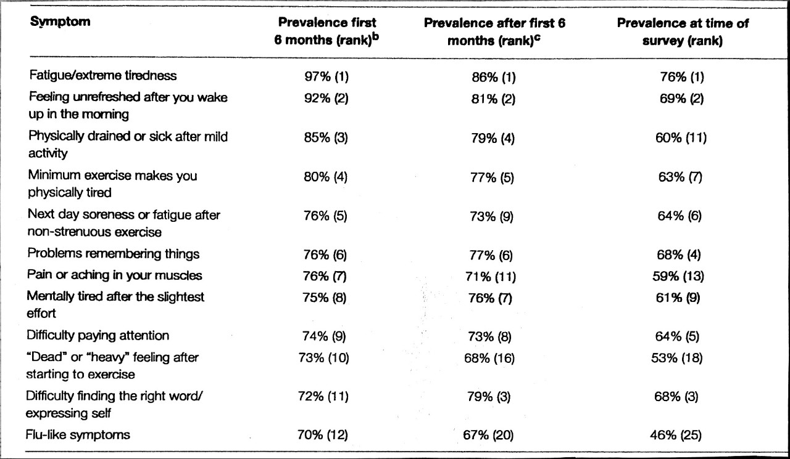
12 common symptoms ME/CFS Table 4. Chu et al.
Median
Illness
Duration
12 years

Slide 39
Symptom variability in ME/CFS

Slide 40
Symptom variability in pediatrics
Defined onset (either over 1-2 weeks or non-recovery after defined illness)
Profound exhaustion, malaise, headache, aches and pains, dizziness, excessive but disturbed sleep, difficulty ‘thinking’
Persists for weeks to several months
Then may be able to move around but any activity (physical or cognitive) results in exacerbation of symptoms

Slide 41
Symptom variability
Chronic daily headache can persist for years – some anti-migraine preventer medications found to ease them
Sleep disturbance can change to day-night reversal, fragmented sleep (with nightmares) or hypersomnolence
Cognitive (brain fog), attention, information retrieval, effort required to learn new information – major problems

Slide 42
Outcomes in pediatrics
Slow gradual improvement if supported
‘Boom/bust’ trajectory with some personalities
Young people – long term follow up (>1000 young people) – majority improve/recover
20% significantly affected long term (rate <6/10)
20% not recovered but manage ‘well’ with adjustments (rate 7-9/10)
Of those who report recovery average duration 5 years (range 1-16 years) (rating 9-10/10)

Slide 43
How does ME/CFS present over time in adults?
An unknown number recover early (<6-12 mo)
The illness in many waxes/wanes
The illness gradually improves or remain stable
An unknown number decline insidiously

Slide 44
Useful Diagnostic instruments in ME/CFS

Slide 45
Instruments to measure signs and symptoms
Primer outlines symptoms to assist diagnosis
Main instruments that are useful are to assess:
  depression (Beck)
  Anxiety
  Orthostatic intolerance (described well by Peter Rowe in the primer)

Slide 46
How can medical providers assess symptom severity, impaired function, and PEM?
Mental health screen (we use HADS* plus medical history)
Ideally SF-36 (RAND-36): but complex scoring
Fibromyalgia Impact Questionnaire (FIQ-R) and Pain Diagram
HUA (Hours of Upright Activity)--- time spent with feet on floor (sitting, standing, walking)
Good Day/Bad Day examples
Take a good history about the consequences of physical, cognitive, emotional and upright activity (PEM)
Orthostatic testing---in clinic: 10 min Stand Test (10 min NASA Lean Test)
Assess cognitive impairment as indicated (consider neurocognitive testing)
*Zigmond AS, Snaith RP. The hospital anxiety and depression scale. Acta Psychiatr Scand.
1983 Jun;67(6):361-70. PMID: 6880820 DOI: 10.1111/j.1600-0447.1983.tb09716.x

Slide 47
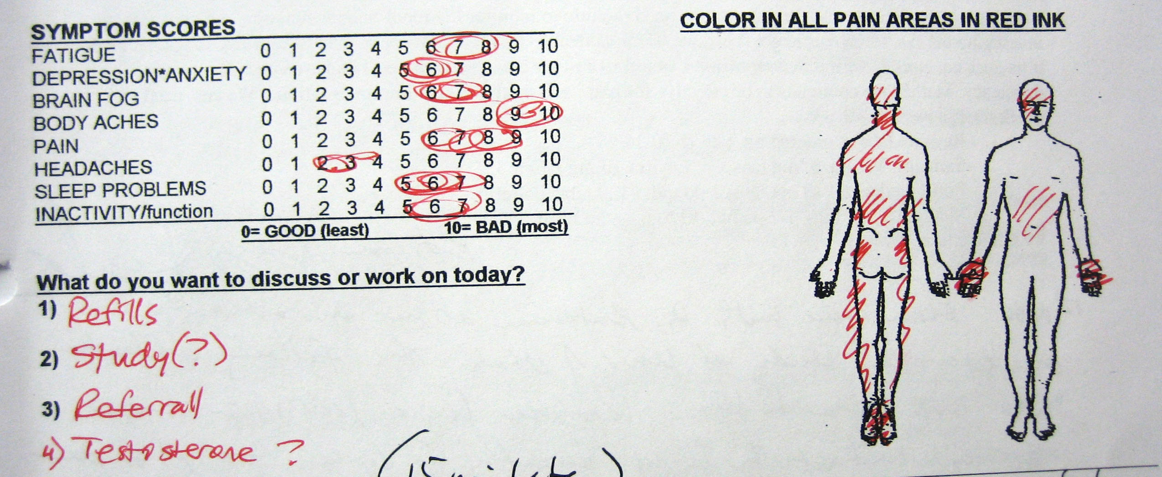
Communicating efficiently about multisystem illness,
fatigue, pain, reduced function

Slide 48
Good Day/Bad Day Questionnaires*
Average number of GOOD/BAD days per MONTH:
Average hours of UPRIGHT activity (HUA) on a GOOD/BAD day:
  sitting, standing, walking --- activities with FEET ON FLOOR
Average hours of non-upright activity on a GOOD/BAD day:
  lying in bed, reclining, elevating feet, sitting cross legged
(Hours of upright activity + Hours of non-upright activity = 24 hours)
Give examples of activities/tasks you CAN do on a good/bad day:
Give examples of activities/tasks you CAN NOT do on a good/bad day:
*Designed for use at BHC by Lucinda Bateman MD

Slide 49
My best tool to communicate impaired function: HUA
HUA: Hours of “Upright” Activity:
The # hours spent with feet-on-floor in 24 hours (sitting, standing, walking)
Must ask the question clearly to be sure
time spent sitting is considered in the total.
Thanks and credit to David Bell MD

Slide 50
Typical HUA*
Hours of Upright Activity in 24 hours
Normal healthy folks: HUA 14-17
Chronic illness/FM: HUA 10-12
ME/CFS HUA 0- 7
*based only on BHC clinical data
and my own experience

Slide 51
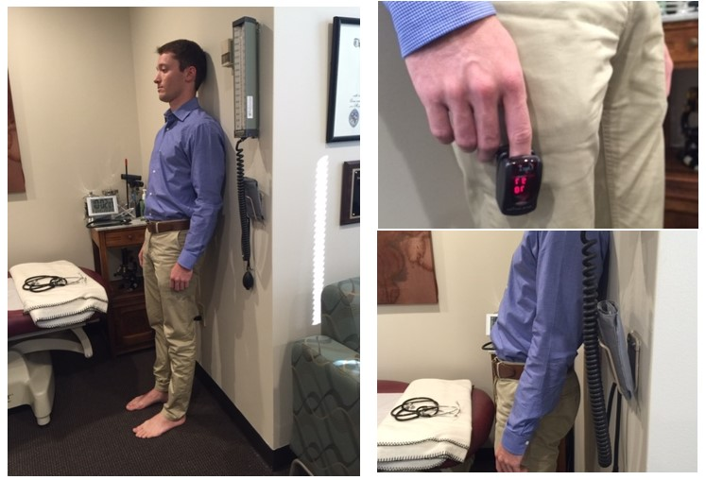
10 minute “NASA” Lean test—the standing portion after resting supine measurements.

Slide 52

32 year old woman with fatigue, severe migraines, fibromyalgia, depression, dizziness unresponsive to traditional therapies.
Supine (10-15 min in quiet room):
Supine BP: 116/60 Pulse: 85 PULSE PRESSURE: 56
Standing straight with shoulder blades against the wall and feet 6" from the wall
Standing 0 minute BP: 104/80 Pulse: 85
Standing 2 minute BP: 96/70 Pulse: 116
Standing 4 minute BP: 98/78 Pulse: 120 Arms "almost feel like they are tingling"
Standing 6 minute BP: 91/73 Pulse: 125 Lightheaded and dizzy (as if she is spinning)
Standing 8 minute BP: 96/74 Pulse: 122 Increased lightheadedness, nausea
Standing 10 minute BP: 93/80 Pulse: 120 Increased "electrical buzz"
PULSE PRESSURE: 13
Summary:
-27 mmHg drop in SBP meets criteria for systolic orthostatic hypotension (> 20 mmHg decrease)
+41 bpm increase in Heart Rate meets criteria for POTS
Postural Orthostatic Tachycardia Syndrome(>30 bpm increase for adults, >40 for youth)

Slide 53
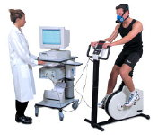
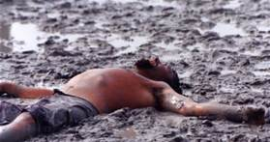
CPET Provides Objective & Descriptive
Measures of PEM
Objective
  No malingering or faking
  Metabolic/Ventilatory/Cardiac
Descriptive
  Values can be compared with normative
  data
  Comparison one day to the next
    “Serial testing”

Slide 54
Maximal Exercise ‘Induces’ a Controlled and Defined Post-exertional State
Pre-testing Post-testing

Slide 55
One CPET Demonstrates Impairment/Deconditioning
American Medical Association Guidelines:
Severity of Impairment | Peak VO₂ (ml/kg/min) | # of patients | Group VO₂ (ml/kg/mi) | Predicted VO₂ (ml/kg/min)
None to Mild | >25 | 33 | 29.5 ± 0.9 | 38.6 ± 1.2
Mild to Mod | 20-25 | 72 | 22.1 ± 0.2 | 35.3 ± 0.8
Mod to Severe | 15-20 | 77 | 17.2 ± 0.2 | 34.2 ± 0.6
Severe | <15 | 21 | 12.1 ± 0.5 | 33.0 ± 0.6
VanNess et al, 2003

Slide 56
Impaired Cardiovascular Response
 | None: N=20 | Mild: N=67 | Moderate: N=72 | Severe:20
Pred Peak HR | 180 | 177 | 177 | 173
Actual Peak HR | 163 = 90% pred | 147 = 83% pred | 133 = 75% pred | 117 = 67% pred
70% Pred HR | 126 | 124 | 124 | 121
70% Actual HR | 114 | 102 | 93 | 82
Overestimation using 70% pred/actual | 10% harder = 80% actual | 17% harder = 87% actual HR | 25% harder 95% actual HR | 33% harder 103% actual HR
70% Submax = | Submax | Max | Max | Max
89% have chronotropic incompetence

Slide 57
PEM in Women With CFS:
VanNess, J.M., C.R. Snell, L. Bateman, T Stiles and S.R. Stevens. J. of Women’s Health, 19(2), 2010.

Slide 58

CPET: Abnormal Recovery Responses
Abn
Within 24 hours, 85% of CON indicated full recovery in contrast to 0% of CFS patients.
The remaining 15% of CON recovered within 48 hours.
Only one CFS patient recovered within 48 hours.
Notes:
It took our CFS subjects 4 days to recover from a bicycle exercise test and the healthy controls 1 day. Within 24 hours, 85% of controls indicated full recovery in contrast to 0% of the CFS patients. The remaining 15% of controls recovered within 48 hours. Only one CFS patient recovered within reported recovery within 48 hours. Every single healthy but deconditioned control completely recovered in two days whereas only 1 patient reported recovery in that same time frame. This clearly demonstrates an altered response in the ability to recover from the standardized physical stressor of an exercise test.

Slide 59
Conclusions from just one CPET
1 CPET is not enough to identify symptom origins
2 tests are needed to show differences:
  Between test 1 and test 2 for ME/CFS
  Between groups for ME/CFS and Control
Serial testing: Test-retest
  Measures are not reproducible
  Discriminates ME/CFS from Controls

Slide 60
Test-Retest Strategy
Test 1 Test 2
Pre-testing
“Post-Exertional
State”

Slide 61
2-Day CPET Symptoms
Average number of symptom categories, number of symptoms during the two-day cardiopulmonary exercise test and thereafter, and days to recover.
Group | Symptom Categories | Two-day CPET Symptoms | Thereafter Symptoms | Days to Recover
ME/CFS | 9 ± 3 | 15 ± 8 | 5 ± 3 | 4.5 days*
Control | 3 ± 3 | 6 ± 2 | 0 | 1 days
Fast Recovery PEM
  49% took 4.5 days
Slow Recovery PEM
  51% longer than 7 days
Group | Symptom Categories | Two-day CPET Symptoms | Thereafter Symptoms | Days to Recover
ME/CFS | 8.55 ± 3.36 | 15.35 ± 7.70 | 4.98 ± 2.77 | 4.5 days*
Control | 2.60 ± 2.58 | 5.50 ± 1.78 | 0 | 1 days
Group | Symptom Categories | Two-day CPET Symptoms | Thereafter Symptoms | Days to Recover
ME/CFS | 8.55 ± 3.36 | 15.35 ± 7.70 | 4.98 ± 2.77 | 4.5 days*
Control | 2.60 ± 2.58 | 5.50 ± 1.78 | 0 | 1 days

Slide 62
2-Day CPET Timepoints
T1: Immediately after the first exercise test
T2: 24 hours after the first test
T3: Immediately after the second test
T4: 24 hours after the second test
T5: A week after the CPETs
Group | Symptom Categories | Two-day CPET Symptoms | Thereafter Symptoms | Days to Recover
ME/CFS | 8.55 ± 3.36 | 15.35 ± 7.70 | 4.98 ± 2.77 | 4.5 days*
Control | 2.60 ± 2.58 | 5.50 ± 1.78 | 0 | 1 days
Group | Symptom Categories | Two-day CPET Symptoms | Thereafter Symptoms | Days to Recover
ME/CFS | 8.55 ± 3.36 | 15.35 ± 7.70 | 4.98 ± 2.77 | 4.5 days*
Control | 2.60 ± 2.58 | 5.50 ± 1.78 | 0 | 1 days

Slide 66
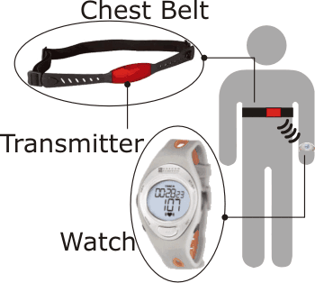
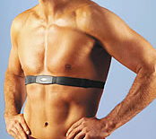
Heart Rate Monitoring Tools
Heart Rate Monitor
Tips & Tricks
Perceived Exertion
Activity Log

Slide 67
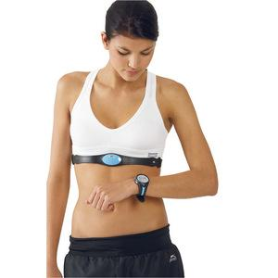

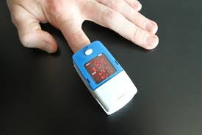

Heart Rate Monitors
Chest strap
Wrist watch
Phone apps
Pulse oximeter
Manual

Slide 68
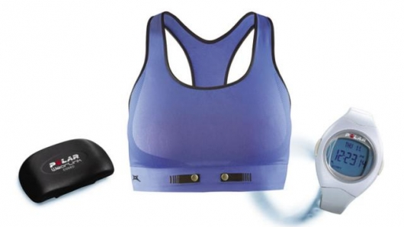
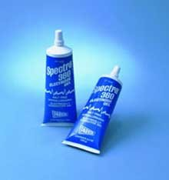
Tips & Tricks
Comfort is Key
Good Contact
  electrode gel
Don’t let it drive you crazy
Tie how you feel to what your HR is telling you

Slide 69
Effective Interventions

Slide 70
A TIME TESTED TREATMENT APPROACH
1) Identify and treat all identifiable medical conditions. (co-morbid
or underlying)
2) Learn how to "pace" activity to prevent, and reduce severity/duration of “Post Exertional Malaise” [PEM]
3) Address the major aspects of illness:
Mental health: Reduce grief/despair. Seek insight.
Orthostatic intolerance (OI): if present (good literature available)
Pain: when pain is a stressor
Sleep: when corrupted and non-restorative
Fitness: As compatible with illness manifestations. PACING trumps FITNESS

Slide 71
Best interventions as reported by young people
Early diagnosis and understanding
Assistance with management plan
Symptom management
What symptoms are most problematic?
  Sleep, headache, dizziness, pain, cognitive
Manage in sequence
Lifestyle management
  Including social contact
  Some educational input
  Some physical activity
  Something enjoyable outside of home each week
Young person makes these decisions

Slide 72
Additional supports
May involve cardiologist if simple measures for POTS not effective
Sleep physician
Mental health team
Gynaecologist for significant dysmenorrhoea and exacerbation of CFS symptoms during period
Gastroenterologist if some new food intolerances
Occasionally pain team or rheumatology if strongly positive ANA but no other indicators of autoimmune disease

Slide 73
If plan is not working well:
Reasons are often family, school, or personality (boom and bust personality- ‘all or nothing’)
Self-management program by the rehab. team
  Physiotherapist, Occupational therapist, teacher and psychologist
  Assessed beforehand – goals established
Inpatient or intensive outpatient program and currently having a trial of an online program due to COVID-19 restrictions
3-4 young people at a time for 4-week program

Slide 74
Most common responses regarding helpful interventions
Being understood
Assistance with education – planning flexibility and advocacy
Support with self-management & providing framework to design one.

Slide 75
Recognition and Prevention of PEM
Keep a symptom diary
Pacing/energy conservation
Heart rate monitoring

Slide 76
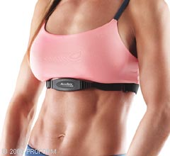
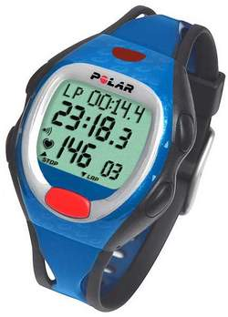
Preventive Medicine
Activity Biofeedback
  HR at anaerobic threshold
Energy Conservation Therapy
  Pacing
  Rest breaks
  Balance activity

Slide 77
Energy Conservation Therapy
Pacing
  Rest breaks
Body Position
  Sit vs. stand
Joint Protection
  Assistive devices
Activity Planning
  Balance light and heavy tasks

Slide 78
Unique challenges + Solutions in the pediatric population

Slide 79
Challenges:
Being understood
Advocacy and flexibility in being able to continue with education to achieve aspirations or a satisfying occupation/activity
Allowing them permission to seek help for mental health issues when they are ready
Recognising that it is quite ‘healthy’ to be ‘fed up’ and frustrated with the restrictions of the illness – if they were happy not seeing friends, not attending school, not doing activity and being home with parents – we would be much more concerned about them

Slide 80
Challenges for family
Challenges for parents and siblings
Developmental tasks of adolescence are hard enough in well children
  parents negotiating when to push or excuse,
  when to accept behavior or set limits,
  when to allow some risk-taking and when to advocate
Roles within the family and relationships with siblings can be problematic especially if a parent has been unwell and is very protective (or dismissive)

Slide 81
Resources & Final Remarks

Slide 82
Recommended references:
Dr. Lucinda Bateman
Initiating care of a patient with myalgic encephalomyelitis/chronic fatigue syndrome (ME/CFS). Lapp CW. Front Pediatr. 2019 Jan 23; 6:415.
Dr. Katherine Rowe
Myalgic encephalomyelitis/chronic fatigue syndrome diagnosis and management in young people: a primer. Rowe PC, Underhill RA, Friedman KJ, Gurwitt A, Medow MS, Schwartz MS, Speight N, Stewart JM, Vallings R, Rowe KS. Front Pediatr. 2017 Jun 19;5:121.
Dr. Mark VanNess
Post-exertional malaise symptoms distinguish ME/CFS subjects from healthy controls. Mateo, L. J., Chu, L., Stevens, S., Stevens, J., Snell, C. R., Davenport, T., & VanNess, J. M. Work. 2020. 66(2), 265–275. https://doi.org/10.3233/WOR-203168

Slide 83
Additional Resources for Clinicians
Batemanhornecenter.org
Provider Resources page https://batemanhornecenter.org/providers/
U.S. ME/CFS Clinician Coalition
Mecfscliniciancoalition.org (currently in last stages of development)
Produced 6 page handout with basic medical information, advice and references:
“US ME/CFS Clinician coalition consensus guidelines for diagnosing and treating
ME/CFS”
https://www.omf.ngo/2019/09/01/new-guidelines-for-diagnosing-and-treating-me-cfs/

Slide 84

PEM Resources
Workwellfoundation.org
PEM Timecourse Handout
PEM Research Pubs
Pem Videos
Pem Webinar
Medbridge continuing education
This Photo by Unknown Author is licensed under CC BY-SA-NC

Slide 85

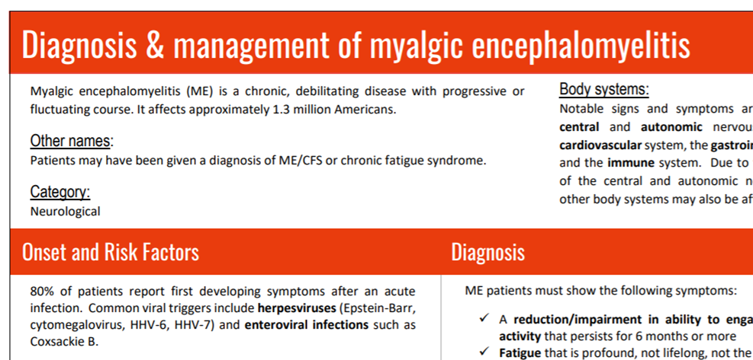
#MEAction recommended resources
Diagnosis and management of myalgic
encephalomyelitis (2018)
ME Research Summary (2019)

Slide 86
Outreach: www.meaction.net
Add yourself to the global directory of ME-literate clinicians
Reach out to your workplace to engage them in taking the Unrest CME
Volunteer for our Postcards to Doctors outreach initiative
Volunteer for our BIPOC Outreach initiative
Donate – suggested donation for seminar (www.meaction.net/donate)
Fill out the feedback form to help us know what will serve you best
Write to info@meaction.net or jaime@meaction.net if you would like to volunteer/get involved at a deeper level

Slide 87
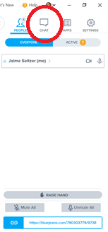
Q & A
Type your question in the chat box in the upper, right-hand corner of BlueJeans.
Address your question to a particular presenter: “Dr. Rowe, how do you rule out other fatiguing diseases in the pediatric population?”
If you don’t get your question addressed, don’t worry! If a significant number go unaddressed, we will create a follow-up Q & A.

Slide 88

Thank you!
Dr. Lucinda Bateman, MD Dr. Mark VanNess, PhD Dr. Katherine Rowe, MD

